Slide 1
Voice Verification Code API Introduction By Jincui Niu

Slide 2
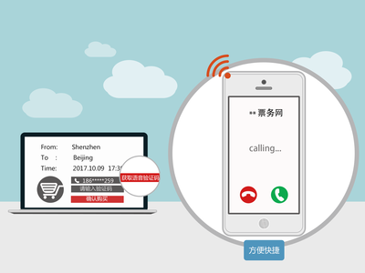
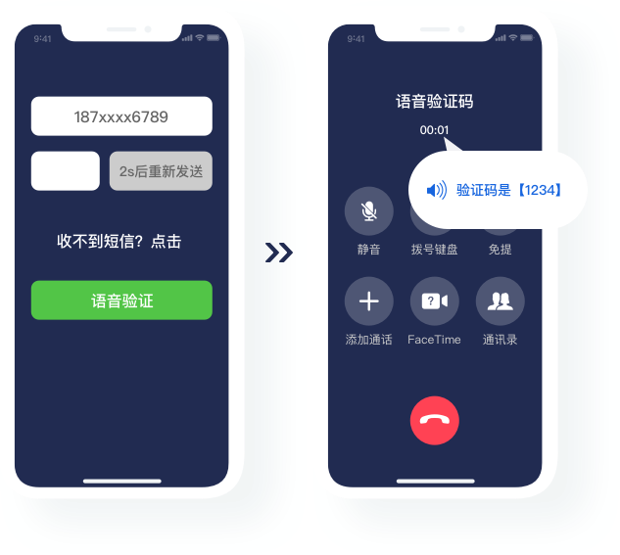
Voice Verification Code API
1.Capabilities
Application call method, based on IMS network resources, Send various voice verification code broadcasts to end users.
2. Innovation Points of API capabilities
Security Enhancement:Voice verification codes have a higher security experience and can effectively ensure the security of user data, making them suitable for scenarios with high requirements for identity verification
Verify user identity: In business scenarios related to user identity security, such as remote login, identity verification, payment verification, etc., voice verification codes are highly effective preventive measures.
High arrival rate: The arrival rate of voice verification codes is close to 100%, and they will not be missed due to interception or other reasons.
3. Typical Application Scenarios
account registration and authentication/password retrieval
Online payment
In some environments with large transactions and fund changes, compared to passwords set by users themselves, using random and dynamic voice verification codes improves security.
The security measures of operators are relatively reliable, and the process of issuing random dynamic passwords is not easily intercepted by third parties.
For financial industry apps, when users register and log in to websites or apps using their mobile phone numbers, they can complete user identity confirmation by calling the user and providing a verification code.
The process of retrieving the password involves calling the user's registered mobile phone, providing the verification code, confirming the user's identity, and completing the password reset.

Slide 3

Voice Verification Code API
4.Application effects
Voice verification codes provide fast, secure, and extensive verification services, not only enhancing user experience but also strengthening security, while expanding coverage, reducing costs, and improving efficiency. They are an effective method of identity verification.
5. Introduction to Business Processes
The OpenGW gateway first assigns an enterprise ID and token to the customer for calling the voice notification API, and then can initiate the voice verification code business process:
1. The caller initiates a call, and the enterprise application server calls the voice verification code API (carrying the called number and verification code) to request a call.
2. Play the voice verification code after the call to the called party B is connected.
web/Clientl/APP/portal
enterprise application servers
1. Call the voice verification code API interface
(Submit the called number and verification code)
Open Gateway Voice Verification Code
2. Call the UE and broadcast verification code after connection
Operator IMS network
UE

Slide 4
Voice Verification Code API
6. API interface parameters
Interface Name | Voice notification
API Description | Call the specific user and play the specified verification code content after connecting
Requested parameters | VCCID:Enterprise ID
 | calling number
 | Called Number
 | The verification code to be played
 | Repeated playback count
 | Event push URL
 | Is it recorded
 | User defined business data
Response parameters | Call result

